Slide 1
GBase 8s数据库锁与隔离级别

Slide 2
目标
理解为什么我们需要并发控制机制
理解锁及锁的类型
理解锁对性能的影响
理解各种隔离级别（ Isolation Levels）
理解调整锁机制的原则:
掌握定义onconfig文件中锁相关的参数
能够解决锁相关的一些潜在问题 （脏读、幻影读、不可重复读和死锁）

Slide 3
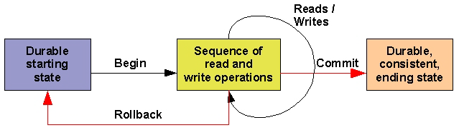
事务（Transactions ）
事务
是指一个程序（语句序列），能保证数据库从一个一致状态到另外一个一致状态。
事务是必须全部完成或根本就不执行的修改序列。
数据库服务器保证在事务范围内执行的操作完整且正确地提交至磁盘，否则数据库会复原至事务启动之前的状态
事务具有ACID特性

Slide 4
事务（Transactions ）
事务的ACID特性
A – Atomicity
操作序列要么完整的执行，否则什么也不做
C – Consistency
一致性，事务执行后，保证数据库从一个一致性状态到另外一个一致性状态 (准确, 完整)
I – Isolation
隔离，一个事务的中间状态对其他事物不可见 (换句话，每个用户感觉他们是在单独使用数据库)
D – Durability
持久性，事务的有效性，不会应用硬件或者软件的失败而丢失

Slide 5
事务 – Isolation
隔离级别(Isolation)
多个同时运行的事物之间不会互相影响彼此的执行
每个用户感觉自己的事务都是排他的执行
同时发生的其他事务应该出现在当前事务的前或者后
类似一个事务中的”序列”
隔离级别用来定义多大程度的隔离多个不同的事务
Dirty read
Last committed read
Committed read
Cursor stability
Repeatable read
Notes:
如果数据库支持事务的并发控制能力，用户和程序员就可以不用担心多个事务的同时运行了。

Slide 6
并发控制
隔离 (+ 一致性) => 并发控制
多个事务可能访问和修改相同的资源
只要多个进程共享资源，就需要对访问进程进行排队控制
并发控制:
考虑事务访问数据库对象 (database, table, page, row, index key) 产生预期的结果
数据库内部将生成多个并发事务访问资源的操作序列表，并且每一个事务内部的各个操作都需要序列化

Slide 7
事务的串行调度
串行调度
一个事务内的所有操作必须在另外一个事务开始前完成
每一个事务中的操作序列都必须是独立于其他事务的
事务之间不能有重叠
示例：
假设事务 T1 有如下操作
O1 O2 O3
假设事务 T2 有如下操作
P1 P2 P3
O1O2P1O3P2P3 是一个串行调度
O1P1O3P2P3O2 不是一个串行调度
事务T2中操作 O3 必须在 O2 后

Slide 8
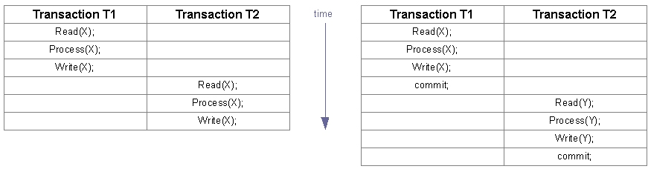
串行调度
示例：
事务 T1 、 T2 更新数据库中不同的对象（X,Y），所以T1 和 T2 可以并发的运行
操作序列总是正确的，但是不能采用最优使用计算机资源 (从并发度和性能角度考虑)

Slide 9
如何改进性能? 非串行调度
允许事务同时执行 (并发)
一个事务内的操作可以在其他事务提交前开始执行
事务中操作调度并发的执行称为：非串行调度，也称为并发调度

Slide 10
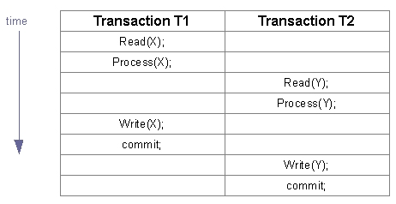
并发调度 – 举例和问题
问题：如果操作没有一个“有意义”的顺序，我们将得到一个非预期的执行结果
调度的典型问题:
Dirty read 脏读
Non-repeatable read 非重复读
Phantom read 幻影读

Slide 11
脏读 –问题与举例
脏读：事务T2读取到了事务T1没有提交的结果
事务T1 读取记录，然后更新记录
事务T2 读取了更新后的记录
事务 T1 后续操作可能失败，导致更新的记录回滚
而同时，事务T2 使用了一个不准确或者说没有提交的值
如果事务是串行的话，预期的情况是：如果T1失败，T2将采用更新前的值
操作 | 事务T1 | 事务T2
用户1启动事务T1 | begin work;
用户1更新一条记录 | Update employee set salary=50000 where empno=100;
用户2启动事务T2 |  | begin work;
用户2查询employee表所有记录 |  | Select * from employee;
用户1的操作回滚 | Rollback;

Slide 12
不可重复读 –问题和举例
不可重复读：如果事务 T1 中多个读操作返回不同的结果
事务 T1 读取一个对象
事务T2 读取并更新同一个对象
事务T1 再一次读取同一个对象,但是读取到一个修改后的新值
如果事务是串行的话，预期的情况是：如果事务是只读的，则每次读取的结果是一致的
操作 | 事务T1 | 事务T2
用户1启动事务T1 | begin work;
用户1读取一条记录 | Select * from employee where empno=100;
用户2启动事务T2 |  | begin work;
用户2更新更新一条记录，用户1执行同样的查询语句，返回与上次不同的查询结果。 |  | Update employee set salary = 50000 where empno=100
 | Select * from employee where empno=100;

Slide 13
幻影读 –问题与举例
幻影读：如果事务T1在同样的情况下多次执行SELECT读取的结果不同
事务T1 从一个表中检索特定条件的记录返回m条记录
事务T2 往表中insert/delete其他的满足相同条件的记录
事务T1 再次以相同的条件检索该表的数据将返回 <>M条的记录
如果事务是串行的话，预期的情况是： 在一个事务内的第一次、第二次查询应该返回相同的结果
操作 | 事务T1 | 事务T2
用户1启动事务T1 | begin work;
用户1基于某个查询条件执行一条查询语句 | Select * from employee where salary>30000;
用户2启动事务T2 |  | begin work;
用户2插入一条记录，该记录能够匹配用户1的查询条件 |  | Insert into employee(empno,salary) values(123,35000)
用户1使用同样的查询条件进行查询，查询结果比上一次多一条记录 | Select * from employee where salary>30000;

Slide 14
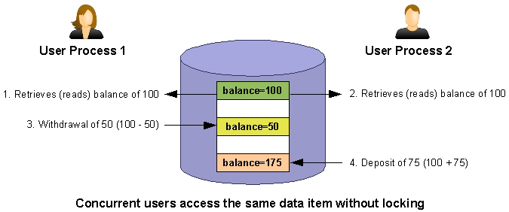
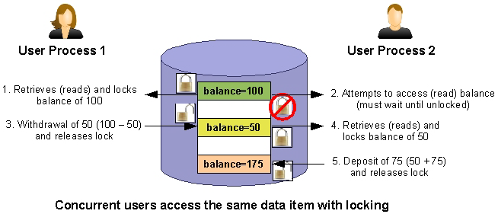
锁机制
在多用户数据库系统中，锁非常重要
用户可以锁定一个对象，可以防止其他用户修改锁定的对象
多个并发用户访问数据库数据的情况下，为了保证数据的完整性，锁是必需的
Notes:
Source:
Book: Informix Unleashed
Macmillan Computer Publishing.
http://docs.rinet.ru/InforSmes/index.htm

Slide 15
锁机制
锁作为关联到数据项的对象
程序可以显示对数据加锁，数据库系统也可以隐式的对对象进行加锁
锁描述事务所操作对象的一种状态信息
锁的类型:
Shared locks: 共享锁，多个用户可以同时读取相同的记录
Exclusive locks: 排他锁，同一时间仅仅有一个用户可以读取相同的记录
Promotable (Update) lock: 提升锁，可以从升级 (从共享锁提升为排他锁) 或者降级 (反之亦然)
Intent lock: 专一锁，是一种表级锁，标识在该表上有一个游标在读取数据
Notes:
To ensure data consistency and integrity in a multiuser (concurrent access) environment, a database
server must place locks on data being modified.
Shared
A shared lock reserves its object for reading only. It prevents the object from changing while the lock remains. More than one program can place a shared lock on the same object. More than one object can read the record while it is locked in shared mode.
Exclusive
An exclusive lock reserves its object for the use of a single program. This lock is used when the program intends to change the object. You cannot place an exclusive lock where any other kind of lock exists. After you place an exclusive lock, you cannot place another lock on the same object.
Promotable/Update
A promotable (or update) lock establishes the intent to update. You can only place it where no other promotable or exclusive lock exists. You can place promotable locks on records that already have shared locks. When the program is about to change the locked object, you can promote the promotable lock to an exclusive lock, but only if no other locks, including shared locks, are on the record at the time the lock would change from promotable to exclusive. If a shared lock was on the record when the promotable lock was set, you must drop the shared lock before the promotable lock can be promoted to an exclusive lock.

Slide 16
锁的类型 (1)
共享锁（lock-S）
如果一个对象上没有排他锁，则共享锁可以加在该对象上
防止其他事务更新数据
但同时，其他事务可以读取该数据 (其他事务可以加共享锁)
多个事务可以在同一个对象上加多个共享锁
排他锁 (lock-X)
如果记录上没有任何锁，排他锁才可以加在该对象上
一旦在记录上加了排他锁，则不能在该记录上增加任何锁了，直至锁释放
防止其他事务读取和修改数据
Notes:
Shared locks prevent other processes from updating the locked object. Other users maintain read
access to the object. Multiple share locks can be placed on a single object.
Exclusive locks are automatically placed by the database server on any object actively being
modified. Exclusive locks prevent all reads except dirty reads. A DBA or user can also explicitly
request an exclusive lock on a database or table to perform administrative or batch operations.

Slide 17
锁的类型 (2)
更新锁 (lock-U)
在更新cursor中使用
更新锁由cursors 含有 ‘for update’ 选项执行时产生的 ，只能在没有排他锁或者更新锁的记录上加更新锁
当锁定的记录真正执行的时候，更新锁将提升为排他锁
Declare update cursor
Begin work
Open the cursor
Fetch the row 为当前行加更新锁
Update the row(使用where current of) 提升为排他锁
Commit work 释放锁
Notes:
Promotable or update locks are placed on objects that are retrieved for update but are not yet
being updated. They prevent other users from acquiring exclusive or promotable locks on the
object. As an example, when you open a cursor with the FOR UPDATE clause, the database
server acquires an update lock on each row fetched. The lock is promoted to an exclusive lock
when the UPDATE WHERE CURRENT statement is executed.
Intent locks are automatically set by IDS. If a row in a table is updated, an exclusive lock is placed on the row and an intent-exclusive lock is placed on the table. This ensures that no other session could place a share or exclusive lock on the table as long as an individual row is locked exclusively

Slide 18
锁的类型 (3)
专一锁 (lock-IX or IS)
由GBase 8s自动分配
如果一条记录上的记录被更新，一个排他锁将分配在该记录上，同时将该记录的表上自动加上专一锁
这能保证没有session可以在该表上增加排他锁，只要该表中有记录被增加了排他锁
Notes:
Promotable or update locks are placed on objects that are retrieved for update but are not yet
being updated. They prevent other users from acquiring exclusive or promotable locks on the
object. As an example, when you open a cursor with the FOR UPDATE clause, the database
server acquires an update lock on each row fetched. The lock is promoted to an exclusive lock
when the UPDATE WHERE CURRENT statement is executed.
Intent locks are automatically set by IDS. If a row in a table is updated, an exclusive lock is placed on the row and an intent-exclusive lock is placed on the table. This ensures that no other session could place a share or exclusive lock on the table as long as an individual row is locked exclusively

Slide 19
Lock 兼容矩阵
如果一行记录已经被加锁，我们是否能够在该行记录加另外一个锁…?
 | 共享锁 | 排他锁
共享锁 | 是 | 否
排他锁 | 否 | 否

Slide 20
Lock的有效期
程序控制数据库锁的有效期
当数据库关闭后，数据库锁将被释放
根据数据库是否使用了事务的情况，表锁的有效期不同
如果数据库没有使用事务（没有事务日志，也不使用commit work语句），显式对一个表加锁，当执行unlock table时，锁将被释放;
当数据库使用了事务，事务结束时，将释放事务持有的所有锁资源

Slide 21
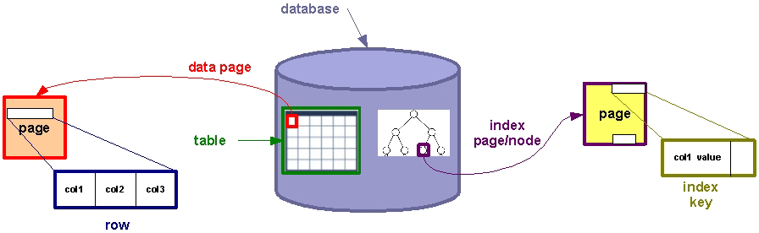
GBase 8s Lock 粒度 (lock 范围) (1)
在GBase 8s中, 我们可以按如下粒度进行加锁:
entire databases 数据库
entire tables 表
disk pages 数据页
single rows, or index-key values 行
一般来讲，锁的粒度越大，并发性就越低，但是程序控制将越简单

Slide 22
GBase 8s Lock 粒度 (lock 范围) (2)
什么情况下采用不同粒度的锁才有效、最优?
数据库锁
数据库管理活动，比如： dbimport 和 dbexport
例如: DATABASE database_name EXCLUSIVE
表锁
当整个表或者表的大部分数据需要更新，加表级锁效率高
LOCK TABLE tab1 IN EXCLUSIVE MODE
LOCK TABLE tab2 IN SHARE MODE
释放表锁: UNLOCK TABLE tab1;

Slide 23
GBase 8s Lock 粒度 (lock 范围) (2)
以下语句将隐式的对表加锁，直到事务结束后释放:
ALTER FRAGMENT
ALTER INDEX
ALTER TABLE
CREATE INDEX (如果不添加online关键字)
DROP INDEX (如果不添加online关键字)
RENAME COLUMN
RENAME TABLE

Slide 24
GBase 8s Lock 粒度 (lock 范围) (3)
不同粒度锁在何时确定?
页级锁
当按数据物理顺序进行访问和更新时，页级锁效率高
修改锁模式为页级锁:
ALTER TABLE tab1 LOCK MODE PAGE;
默认锁模式参数 (ONCONFIG) 文件参数 DEF_TABLE_LOCKMODE.
DEF_TABLE_LOCKMODE ROW
行级锁
OLTP 事务采用行级锁，效率高
修改/创建表并使用行级锁:
CREATE TABLE tab1 (col1...) LOCK MODE ROW;
ALTER TABLE tab1 LOCK MODE (ROW);

Slide 25
GBase 8s Lock 粒度 (lock 范围) (4)
什么类型的数据对象被锁？
更高并发性
更少死锁
更可能出现锁溢出
行锁
页锁
表锁
数据库锁

Slide 26
哪一种锁粒度是最优的呢?
取决于事务本身的特点
当更新表中相对较小一部分数据的时候，采用行级锁将获取最好的性能
如果一个事务频繁的访问整个表的数据，设置更粗的粒度，如表级锁
如果更新数据库中大部分表的大部分数据的情况下, 采用数据库级别的锁
查看表锁模式
oncheck –pt dbname:tablename
dbschema –d dbname –t tablename -ss

Slide 27
事务的隔离级别
在SQL中我们指定事务或者 session 的隔离级别
哪种程度的数据可以接受? Dirty, committed, last committed, etc
为事务设置合适的隔离级别，能避免相应的问题
剩下的就交给数据库来完成你所指定的“隔离级别”的实现

Slide 28

GBase 8s 隔离级别: Dirty Read (1)
语法:
SET ISOLATION TO DIRTY READ;
采用这种隔离级别，数据库服务器不会分配任何锁
查询过程中，可以查询到任何数据行, 甚至那些被修改但尚未提交的记录
Dirty-read隔离级别将产生幻影读，不可重复读的问题
非日志数据库中只有Dirty-read一种隔离级别
表
GBase 8s线程
GBase 8s线程查询数据库表的过程中不检查加锁情况
Notes:
When the isolation level is read uncommitted or dirty read, the database server does not place any locks
or check for existing locks when resolving your query. During retrieval, you can look at any row, even
those that contain uncommitted changes.
Dirty-read isolation makes it possible for your query to retrieve phantom rows.
A phantom row is a row that a transaction inserts, but the transaction is rolled back rather than
committed. Although the phantom row is never committed to the database and therefore never truly
exists in the database, it is visible to any process using dirty-read isolation.
Dirty-read isolation can be useful when:
- The table is static
- 100 percent accuracy is not as important as speed and freedom from contention
- You cannot wait for locks to be released
Dirty-read isolation is the only isolation level available for non-logging databases.

Slide 29
GBase 8s 隔离级别: Dirty Read (2)
Dirty-read 隔离级别应用场景:
静态表 (no updates, read-only tables)
速度比100% 准确更重要的情况
不能等待锁的释放
Notes:
When the isolation level is read uncommitted or dirty read, the database server does not place any locks
or check for existing locks when resolving your query. During retrieval, you can look at any row, even
those that contain uncommitted changes.
Dirty-read isolation makes it possible for your query to retrieve phantom rows.
A phantom row is a row that a transaction inserts, but the transaction is rolled back rather than
committed. Although the phantom row is never committed to the database and therefore never truly
exists in the database, it is visible to any process using dirty-read isolation.
Dirty-read isolation can be useful when:
- The table is static
- 100 percent accuracy is not as important as speed and freedom from contention
- You cannot wait for locks to be released
Dirty-read isolation is the only isolation level available for non-logging databases.

Slide 30
GBase 8s 隔离级别: Committed Read (3)
语法:
SET ISOLATION TO COMMITTED READ;
确保读取的所有记录都是提交到数据库
能避免读到脏数据
读到的所有的记录都是已提交的
当一个进程读完记录后，其他进程就可以修改
表
是否能够加共享锁？
GBase 8s线程
读取一行数据前，先检查是否能在该行加共享锁，但是不实际添加！
如果不能加共享锁，说明该记录正在更新，读操作需要等待或者返回失败
Notes:
Queries in logged databases default to ANSI read-committed isolation. Read-committed isolation is
synonymous with the IBM Informix committed-read isolation. Read-committed isolation ensures that all
rows read are committed to the database. To perform a committed read, the database server attempts to
acquire a shared lock on a row before trying to read it. It does not place the lock rather, it checks
whether it can acquire the lock. If it can, it is guaranteed that the row exists and is not being updated by
another process while it is being read. Remember, a shared lock cannot be acquired on a row that is
locked exclusively, which is always the case when a row is being updated.
As you are scanning rows using committed read, you are not looking at any phantoms rows or dirty data.
You know that the current row was committed (at least when your process read it). After your process
reads the row, however, other processes can change it.
Committed reads can be useful for:
- Lookups
- Queries
- Reports that yield general information

Slide 31
GBase 8s 隔离级别: Committed Read (4)
committed read, 在读取数据前，数据库server尝试在记录上加共享锁
加锁前，需要先检查是否可以对对象加共享锁，但是不加
如果可以加锁，则要保证要加锁的记录没有其他进程正在更新
当记录正在更新时，记录上有排他锁，此时我们不能对这些记录加共享锁
Notes:
Queries in logged databases default to ANSI read-committed isolation. Read-committed isolation is
synonymous with the IBM Informix committed-read isolation. Read-committed isolation ensures that all
rows read are committed to the database. To perform a committed read, the database server attempts to
acquire a shared lock on a row before trying to read it. It does not place the lock rather, it checks
whether it can acquire the lock. If it can, it is guaranteed that the row exists and is not being updated by
another process while it is being read. Remember, a shared lock cannot be acquired on a row that is
locked exclusively, which is always the case when a row is being updated.
As you are scanning rows using committed read, you are not looking at any phantoms rows or dirty data.
You know that the current row was committed (at least when your process read it). After your process
reads the row, however, other processes can change it.
Committed reads can be useful for:
- Lookups
- Queries
- Reports that yield general information

Slide 32
GBase 8s 隔离级别: Cursor Stability (5)
语法 :
SET ISOLATION TO CURSOR STABILITY;
非更新CURSOR, 游标读的所有记录加上共享锁
共享锁一致将保持，直到下一行记录被读取
通过游标检索数据, 共享锁将一直保持到执行下一个 FETCH语句
表
当前行加共享锁，直至游标指向下一行
GBase 8s线程
数据库服务器在读取记录时会在当前行加共享锁，直到游标fetch下一行记录才释放上一行的锁。
Notes:
With CURSOR STABILITY, a shared lock is acquired on each row as it is read by a cursor. This shared
lock is held until the next row is retrieved. If data is retrieved by using a cursor, the shared lock is held
until the next FETCH is executed.
At this level, not only can you look at committed rows, but you are assured the row will continue to exist
while you are looking at it. No other process (UPDATE or DELETE) can change that row while you are
looking at it.

Slide 33
GBase 8s 隔离级别: Cursor Stability (6)
不仅可以看到提交的记录，也可以保证看到的记录不会被更新
其他进程不能更新 (UPDATE 或者 DELETE) 你所看到的记录
当移动到下一行时，锁才会释放，记录就可以进行修改

Slide 34
GBase 8s 隔离级别: Repeatable Read (7)
语法:
SET ISOLATION TO REPEATABLE READ;
数据库在读取的记录上加共享锁，验证是否可以读取数据
直到事务提交，锁才能释放
其他用户可以读取数据，但是不能修改
可以保证在同一事务中前后两次读取记录是一致的
表
满足条件的行均添加共享锁
GBase 8s线程
数据库服务器在满足查询条件的所有行上添加共享锁，直到事务提交才释放锁

Slide 35
GBase 8s 隔离级别: Repeatable Read (8)
当你必须要信任所有读取的记录，保证记录不被修改。我们可以采用repeatable read. 举例:
关键的, 统计数据 (如：银行账号的余额情况)
关联查询多个表

Slide 36
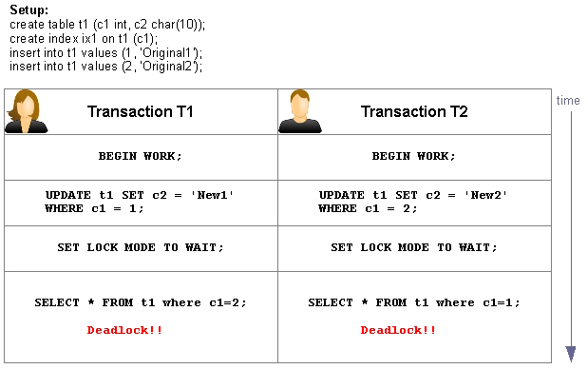
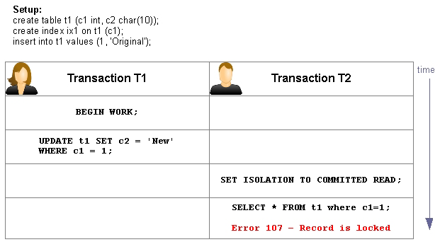
GBase 8s 隔离级别: Last Committed Read (9)
解决Committed Read的不足: 记录被锁，其他进程需要等待
更新的记录不能访问，直到提交。除非采用脏读
由于需要等待更新记录的提交，应用程序性能较低
如果采用脏读则会得到非预期的结果
Notes:
Deadlock error in Informix: error -143 ISAM error: deadlock detected

Slide 37
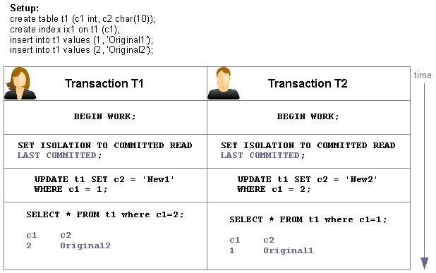
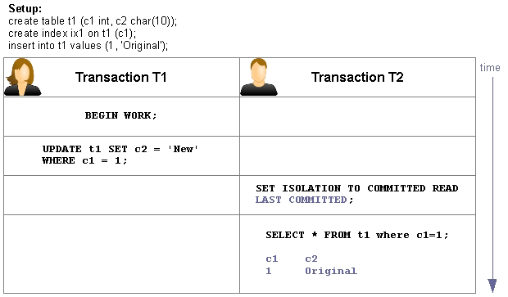
GBase 8s 隔离级别: Last Committed Read (10)
对于Committed Read 隔离级别, 由于其他session在记录上加了排他锁（行级锁），将导致读取数据失败
解决办法: Last Committed Read (乐观锁)
SET ISOLATION COMMITTED READ 的LAST COMMITTED 选项 可以降低读取数据的锁冲突

Slide 38
GBase 8s 隔离级别: Last Committed Read (11)
Last committed Read是一种乐观锁, 常被应用在基于WEB的应用程序中
电子商务的一个例子:
有代表性的，站点允许你可以选择商品增加到购物篮中，但是，此时后台可能正在对商品的价格进行更新。当你再次检查的时候，可能发现商品的价格已经发生变化。
语法:
SET ISOLATION TO COMMITTED READ LAST COMMITTED

Slide 39
GBase 8s 隔离级别: Last Committed Read (11)
相对 Committed Read而言，提高了并发量和系统的吞吐量
返回最新提交的记录版本信息,尽管其他并发的session正在修改记录
这保证修改数据者不会误导其他读数据者
只是可以读取数据，但是不可以delete,update记录
可以通过ONCONFIG参数设置为默认的隔离级别: USELASTCOMMITTED
表需要设置为 行级锁,不能是 页级锁。

Slide 40
GBase 8s 隔离级别对照
隔离级别/语法 | 加锁情况
Dirty read set isolation to dirty read | 读取数据时不加锁，其他进程不影响读
Last Committed read set isolation to committed read last | 返回最后提交的数据版本，不管其他用户正在并发的对此记录进行修改
Committed read set isolation to committed read | 检查记录是否可以加共享锁，但不加锁
Cursor stability set isolation to cursor stability | 当前获取的记录加上一个更新锁当记录更新时将提升为排他锁
Repeatable read set isolation to repeatable read | 在读取的记录上增加共享锁，直到事务提交
Notes:
Dirty read
No locks are placed during reading data and no locks from other sessions will block this reader
Last Committed read
Returns the most recently committed version of the rows, even if another concurrent session holds an exclusive lock
Committed read
Checks for locks being held by other sessions, but does not place a lock itself
Cursor stability
An update lock is placed on the current fetched row. It will be promoted to an exclusive lock as soon an update is executed
Repeatable read
A share lock is placed on every row read to make sure that this query returns the same result set if it is being re-executed in this transaction

Slide 41
不同隔离级别能解决的问题情况
隔离级别 | 是否产生脏读？ | 是否产生不可重复读？ | 是否产生幻影读？
Dirty read | Yes | Yes | Yes
Last Committed Read | No | Yes | Yes
Committed read | No | Yes | Yes
Cursor Stability | No | No | Yes
Repeatable Read | No | No | No
更少死锁
更高并发性
隔离更少的数据

Slide 42
设置 Transaction/Session的锁等待模式
不等待锁的释放 (默认)
如果数据库对象被锁，则立即返回错误：
-244: Could not do a physical-order read to fetch the next row
107: ISAM error: record is locked
SET LOCK MODE TO NOT WAIT;
一直等待锁的释放
一个事务可能发生死锁和挂住，等待资源的释放
SET LOCK MODE TO WAIT;
在锁释放前，等待 n 秒
直到等待N秒后，如果锁一直没有释放将返回锁等待超时错误信息
SET LOCK MODE TO WAIT 20;

Slide 43
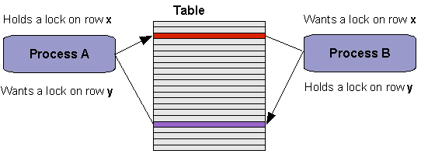
死锁
当2个sessions加锁并且需要获取彼此之间的锁，将发生死锁
过程 A 等待过程B 释放资源
过程 B 等待过程A 释放其他的资源
过程A 等待 B ，而B又等待A …
死循环需要被中断
GBase 8s 自动处理死锁:
在分配一个新锁前，GBase 8s扫描内部的锁信息表，如果检测到死锁发生的条件，向应用程序发出ISAM error code 143
Notes:
In some databases, when multiple users request locks on the same resources, deadlocks can occur.
Deadlocks are serious problems, as they can halt a major portion of the activity in a database system.
IBM Informix Dynamic Server has a built-in, sophisticated mechanism that detects potential deadlocks
and prevents them from happening. To prevent local deadlocks from occurring, the database server
maintains a list of locks for every user on the system. Before a lock is granted, the lock list for each user
is examined. If a lock is currently held on the resource that the process requests to lock, the owner of
that lock is identified and their lock list is traversed to see if waits on any locks are held by the user who
wants the new lock. If so, the deadlock is detected at that point and an error message is returned to the
user who requested the lock.
The ISAM error code returned is:
-143 ISAM error: deadlock detected

Slide 44
GBase 8s – 数据库系统中锁的个数
ONCONFIG 锁相关的参数:
定义初始化锁的个数,在内存中将为锁分配相关的内存空间
GBase 8s锁的初始化最大配置数:500.000.000 locks
动态自动锁分配机制:
在GBase 8s运行期间，如果锁的分配数超过了参数LOCKS设置的值，数据库服务器将增加锁的个数
锁每次以1倍的量增加锁的个数
增长到最大配置数后，GBase 8s 可以分配额外的锁，一共可以增长15次直到锁的个数达到最大值:
每个表每次可以申请 100.000 个locks
500.000.0000 + (15x100.000) = 501.500.000

Slide 45
数据库默认的隔离级别
默认隔离级别在数据库创建时确定的
不同日志类型的数据库有不同的默认隔离级别
数据库日志情况 | 隔离级别
不记事务日志数据库 no logging | Dirty Read
记日志数据库 Logging database | Committed Read

Slide 46
隔离级别、并发控制及锁的示例演示
日志数据库 demodb with log
Create Table
create table test_lock(c1 integer,c2 char(12));
Create unique index idx_test_lock on test_lock(c1);
测试数据
insert into test_lock values(1,'abc');
insert into test_lock values(2, 'abc');
Notes:
Session 1
-------------------------
begin work;
update test_lock set c2 ='qwer' where c1=1;
--commit work;
--------------------------------
Session 2
----------------------------------------------
begin work;
set isolation committed read;
select * from test_lock;
commit work;

Slide 47
隔离级别、并发控制及锁的示例演示
场景1：dirty read USELASTCOMMITTED=NONE
Session 1 | Session 2 | Session 2 output
Begin work; --With committed read default | Begin work; Set isolation dirty read;
 | Select * from test_lock where c1<=3; | 1 abc 2 abc
Update test_lock set c2='new' where c1=1;
 | Select * from test_lock where c1<=3; | 1 new 2 abc
Insert into test_lock values(3, 'new');
 | Select * from test_lock where c1<=3; | 1 new 2 abc 3 new
Roll back;
 | Select * from test_lock where c1<=3; | 1 abc 2 abc
--或者 Commit work;
 | Select * from test_lock where c1<=3; | 1 new 2 abc 3 new
优点：并发性高，不需要锁资源
缺点：脏读、幻影读、不可重复读

Slide 48
隔离级别、并发控制及锁的示例演示
场景2：committed read USELASTCOMMITTED=NONE
Session 1 | Session 2 | Session 2 output
Begin work; | Begin work; Set isolation committed read; Set lock mode to wait 5;
 | Select * from test_lock where c1<=3; | 1 abc 2 abc
Update test_lock set c2='new' where c1=1;
 | Select * from test_lock where c1<=3; | SQL Error -244 锁错误
session2采用committed read对读取的记录试图加S-LOCK，但检测到c1=1的记录上有X-LOCK，出现锁等待事件，超过锁等待时长5秒后报告锁等待超时错误：Error -2441
因为 session2采用committed read对读取的记录不加S-LOCK，所以session1可以对该记录进行更新，并在该记录上加X-LOCK

Slide 49
隔离级别、并发控制及锁的示例演示
场景2：committed read USELASTCOMMITTED=NONE
Session 1 | Session 2 | Session 2 output
Begin work; --With committed read default Set lock mode to wait 5; | Begin work; Set isolation committed read; Set lock mode to wait 5;
 | Select * from test_lock; | 1 abc 2 abc
update test_lock set c2='new' where c1=1; insert into test_lock values(3, 'new');
Commit work;
 | Select * from test_lock; 当session 1结束后执行 | 1 new 2 abc 3 new
--或者 Roll back; |  | 1 abc 2 abc
 | Select * from test_lock; 当session 1结束后执行
优点：相对dirty read能避免脏读的问题
缺点：并发性较dirty read有所降低，容易出现锁等待引起的问题。不能解决幻影读、不可重复读

Slide 50
隔离级别、并发控制及锁的示例演示
场景3：repeatable read
Session 1 | Session 2 | Session 2 output
Begin work; --With committed read default Set lock mode to wait 5; | Begin work; Set isolation repeatable read; Set lock mode to wait 5;
 | Select * from test_lock where c1<=3; | 1 abc 2 abc
Update test_lock set c2='new' where c1=1;
Session1试图更新c1=1的记录，试图在该记录上加x-lock，但发现该记录上已经有s-lock，故出现锁等待事件，当锁等待超时后，出现锁错误：Error -244
session2采用repeatable read对读取的记录（c1<=3）加S-LOCK

Slide 51
隔离级别、并发控制及锁的示例演示
场景3：repeatable read
Session 1 | Session 2 | Session 2 output
Begin work; --With committed read default Set lock mode to wait 5; | Begin work; Set isolation repeatable read; Set lock mode to wait 5;
Update test_lock set c2='new' where c1=1;
 | Select * from test_lock where c1<=3; | SQL Error -244 锁错误
Insert into test_lock values(3, 'new');
Commit work;
session2采用repeatable read需要对读取的记录（c1<=3）加S-LOCK，但是记录c1=1已经被加上了x-lock，故出现锁等待事件，当锁等待超时，则报告锁错误：Error -244
Session1对修改的的记录（c1=1）加X-LOCK

Slide 52
隔离级别、并发控制及锁的示例演示
场景3：repeatable read
Session 1 | Session 2 | Session 2 output
Begin work; --With committed read default Set lock mode to wait 5; | Begin work; Set isolation repeatable read; Set lock mode to wait 5;
Update test_lock set c2='new‘ where c1=1;
Insert into test_lock values(3, 'new');
Commit work;
 | Select * from test_lock ; | 1 new 2 abc 3 new
--或者： Rollback; | Select * from test_lock ; | 1 abc 2 abc
优点：能够解决脏读、幻影读和不可重复读的问题
缺点：只能串行执行，并发性低，需要对读取的记录加s-lock，容易引起锁相关的问题

Slide 53
隔离级别、并发控制及锁的示例演示
场景4：last committed
适用于行级锁情况： Alter table test_lock lock mode(row);
提示：可以通过设置USELASTCOMMITTED控制其他隔离级别自动使用last committed级别
Session 1 | Session 2 | Session 2 output
Begin work; --With committed read default Set lock mode to wait 5; | Begin work; Set isolation committed read last committed; Set lock mode to wait 5;
 | Select * from test_lock where c1>=3; | 1 abc 2 abc
Update test_lock set c2='new' where c1=1;
 | Select * from test_lock where c1>=3; | 1 abc 2 abc
Insert into test_lock values(3, 'new');
 | Select * from test_lock where c1>=3; | 1 abc 2 abc
Rollback;
 | Select * from test_lock where c1>=3; | 1 abc 2 abc
Commit work;
 | Select * from test_lock where c1>=3; | 1 new 2 abc 3 new

Slide 54
隔离级别、并发控制及锁的示例演示
场景4：last committed
Last committed介于dirty read 和committed read隔离级别之间的一种隔离级别
优点：能解决脏读问题，并发性高；不需要锁资源，能避免committed read带来的锁问题，
缺点：幻影读、不可重复读

Slide 55
GBase 8s –锁的监控
监控session的隔离级别:
使用: onstat –g sql 或者 onstat –g ses
查看sid的详细信息: onstat –g sql sid
查看用户进程锁等待情况
使用: onstat –u
查看锁使用和等待情况:
使用: onstat -k
监控数据库事务及其状态:
使用: onstat -x

Slide 56
监控表锁情况—示例
表被锁
ISAM error: key value locked
查询表的在数据库中的内部表号
select hex(partnum) from systables where tabname="test_lock";
返回值为：0x004000D4
查找上锁的用户线索
onstat -k|grep 4000D4 -i
45228970 0 985c8638 452288f0 +IX 4000d4 0 0
45228a70 0 985c8638 45228970 HDR+X 4000d4 101 0 U
Notes:
create table test_lock(c1 integer,c2 char(12));
insert into test_lock values(1,'abc');
insert into test_lock values(2,'def');
alter table test_lock lock mode (row);
--------------------------------
Session 1
-------------------------
begin work;
update test_lock set c2 ='qwer' where c1=1;
--commit work;
--------------------------------
Session 2
----------------------------------------------
begin work;
set isolation committed read;
select * from test_lock;
commit work;

Slide 57
监控表锁情况—示例
查找用户线索对应的会话
onstat -u|grep 985c8638
address flags sessid user tty wait tout locks nreads nwrites
985c8638 Y-BP--- 41 gbasedbt - 9a2a0328 0 3 0 0
查看事务及锁的情况
onstat -x|grep 985c8638
找到相应的session 及SQL
onstat -g ses 41
杀掉session
onmode -z 41
Notes:
create table test_lock(c1 integer,c2 char(12));
insert into test_lock values(1,'abc');
insert into test_lock values(2,'def');
alter table test_lock lock mode (row);
--------------------------------
Session 1
-------------------------
begin work;
update test_lock set c2 ='qwer' where c1=1;
--commit work;
--------------------------------
Session 2
----------------------------------------------
begin work;
set isolation committed read;
select * from test_lock;
commit work;

Slide 58
Thank you !

